Slide 1
Τhe role of parental influence on children's behavior
University of Alicante
Eirini Kouki
PhD Candidate at the university of Alicante
June 2024
eirinigkouki@gmail.com

Slide 2
Τhe role of parental influence on children's behavior
Τhe intricate dynamics of the family unit can:
promote an encouraging environment for positive behavioral, development,
Or conversely
put the stage for offending
tendencies

Slide 3
Τhe positive influence of parents on their children's behavior 1/4
Research consistently emphasizes that authoritative parenting characterized
by a balanced approach of warmness and control,
is significantly associated with reduced incidents of young delinquency.
Xiong, Li, and Xia, (2020), in their longitudinal study of Chinese teenagers highlighted that children raised
by authoritarian parents
exhibited lower levels of delinquent behavior and were less likely to be victims of delinquency.

Slide 4
Τhe positive influence of parents on their children's behavior 2/4
This positive parenting style promotes:
open communication,
sets clear expectations
and imposes consistent discipline
all of which collectively contribute to children's better self-regulation and moral
development,

Slide 5
Τhe positive influence of parents on their children's behavior 3/4
Moreover,
High levels of parental
involvement in a child's education
and daily activities
are essential to foster a sense
of security and belonging,
which are crucial for positive behavior

Slide 6
Τhe positive influence of parents on their children's behavior 4/4
In addition, families with
economic well-being,
mental health
and communication strategies between family members,
Have
a positive effect on their children's behavior,
enhance family cohesion
and reduce any delinquent tendencies

Slide 7
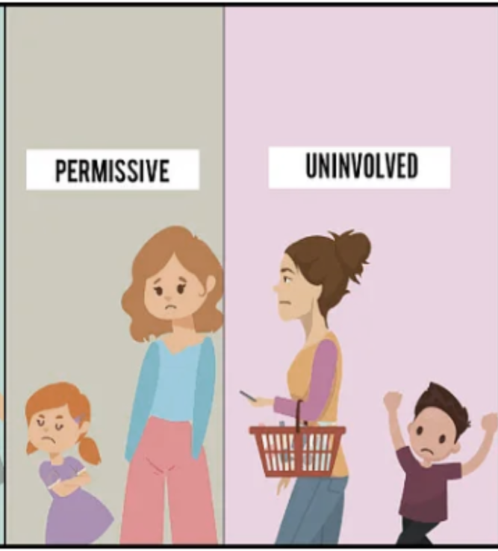
Τhe negative parental influence on their children's behavior 1/3
Permissive and neglectful parenting characterized by low expectations and lack of supervision,
has been associated with higher rates
of behavioral problems and delinquency.
Also,
Walters (2021) further clarifies that
inadequate parental control can often
increase children's cognitive impulsivity,
thus enhancing their propensity for delinquent acts.

Slide 8
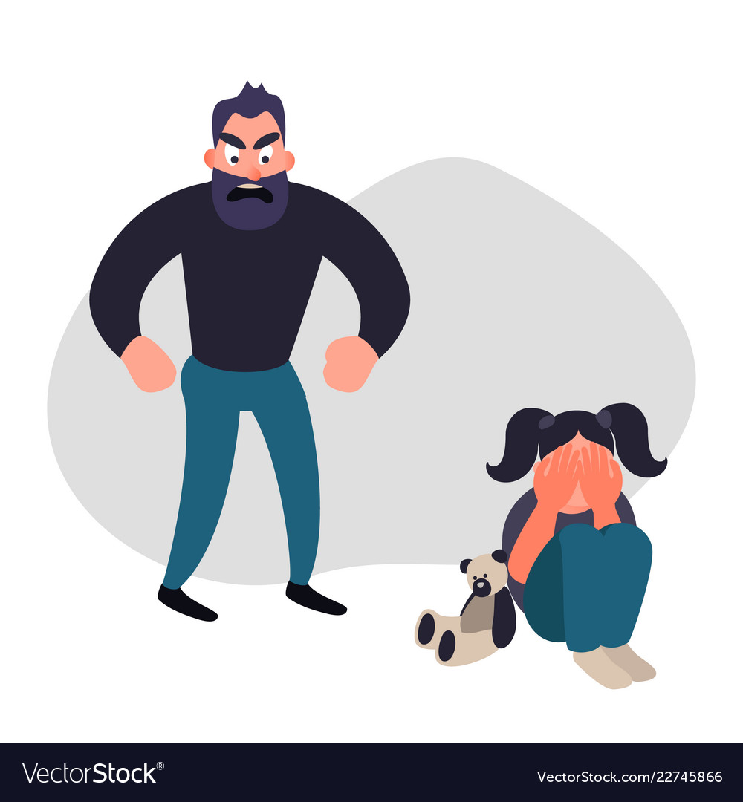
Τhe negative parental influence on their children's behavior 2/3
Additionally
parental behaviors such as
inconsistent discipline,
lack of emotional support
and exposure to domestic violence
are all harmful and strongly increase
the risk of delinquency.

Slide 9
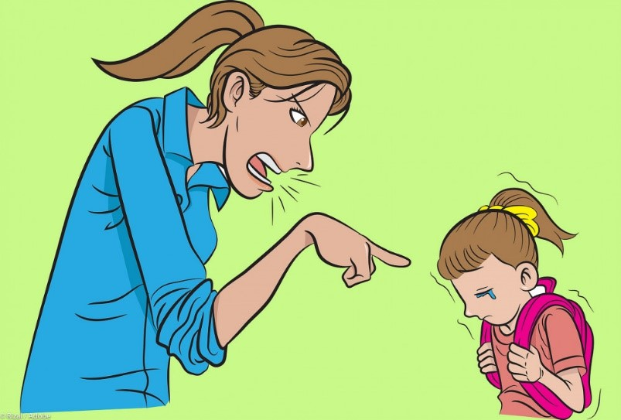
Τhe negative parental influence on their children's behavior 3/3
Finally
the financial difficulties
increased levels of stress
And mental health problems
lead families
to fail to provide and support appropriate parental care and supervision, often inadvertently , contributing to an increase in behavioral problems and delinquency

Slide 10
Conclusion of research
In summary,
the research highlights that the various aspects of parental influence and child behavior interact and are interdependent,
effective parenting, characterized by authoritative practices, active participation and consistent supervision, acts as a strong deterrent against
youth delinquency,
in contrast, neglect and inconsistent parenting, compounded by socio-economic and psychological challenges, significantly increases the risk of delinquent behavior.

Slide 11
the research proposal
Addressing these issues through targeted intervention
programs can reduce the risks, promoting
healthier developmental pathways for children.
Counselling interventions, ranging from family therapies to group sessions and cognitive behavioral approaches,
play a vital role in mitigating delinquent behavior in schools
and promote positive behavioral development and long-term social benefits

Slide 12
sources
Aw, S., Widiarti, P. W., Setiawan, B., Mustaffa, N., Ali, M. N. S., & Hastasari, C. (2020). Parenting and sharenting communication for preventing juvenile delinquency. Inform, 50(2), 177-186.
Barger, M. M., Kim, E. M., Kuncel, N. R., & Pomerantz, E. M. (2019). The relation between parents’ involvement in children’s schooling and children’s adjustment: A meta-analysis. Psychological bulletin, 145(9), 855.
Flanagan, I. M., Auty, K. M., & Farrington, D. P. (2019). Parental supervision and later offending: A systematic review of longitudinal studies. Aggression and violent behaviour, 47, 215-229.
Giotsa, A. (2015). social psychology and social pedagogy: their interdisciplinarity in group counselling for parents.International Journal of Social Pedagogy, 4(1), 219-226.
Hosokawa, R., & Katsura, T. (2019). Role of parenting style in children’s behavioural problems through the transition from preschool to elementary school according to gender in Japan. International journal of environmental research and public health, 16(1), 21.
Jacobsen, W. C. (2019). The intergenerational stability of punishment: Paternal incarceration and suspension or expulsion in elementary school. Journal of Research in Crime and Delinquency, 56(5), 651-693.
Kethineni, S., Frazier‐Kouassi, S., Shigemoto, Y., Jennings, W., Cardwell, S. M., Piquero, A. R., ... & Sundaravadivelu, D. (2021). PROTOCOL: Effectiveness of parent‐engagement programs to reduce truancy and juvenile delinquency: A systematic review. Campbell systematic reviews, 17(3), e1189.
Mwangangi, R. K. (2019). The role of family in dealing with juvenile delinquency. Open Journal of Social Sciences, 7(3), 52-63.
Thanopoulou, M. A., Riga, P., & Tsaroucha, G. (2014). School delinquency in primary education. The role of school and family.
Walters, G. D. (2021). Parental control as a stimulus for youth control: Mediating the parental knowledge–child delinquency relationship with cognitive impulsivity. Crime & Delinquency, 67(5), 717-736.
Weisman, C. B. (2020). Functional Family Therapy: analysis of effect and implementation (Doctoral dissertation, University of Birmingham).
Xiong, R., Li, S. D., & Xia, Y. (2020). A longitudinal study of authoritative parenting, juvenile delinquency and crime victimisation among Chinese adolescents. International journal of environmental research and public health, 17(4), 1405.

